Slide 1
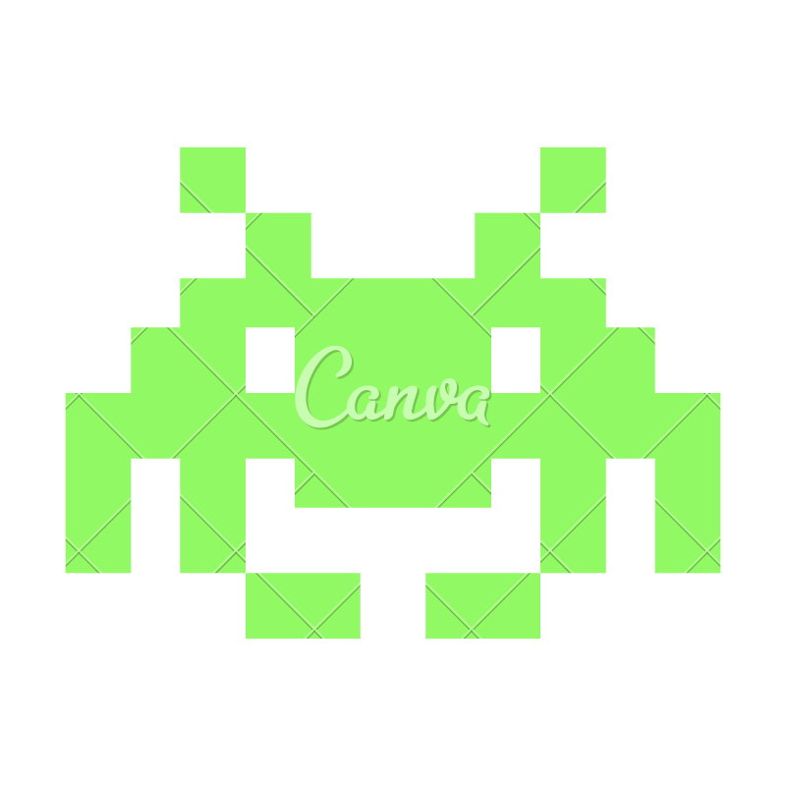


GG
SNAKE VS BLOCKS
M A D E B Y P R A T I K P A T H A K A N D K A N I S H K R A N A

Slide 2
DESIGN
GG
The Main Menu comprises of Play Game,Resume Game,Leaderboard and Exit Game Option.
Leaderboard Page has an option to add your name and HiScores obtained by the players of this game are
Pressing the Play Game Option takes you to the game screen where you have a snake of fixed length 5.
In the gameplay you earn your points by destroying blocks and to help you in your journey you would have a
Shield: To shield you from damages taken during destroying the blocks Magnets:Automatically collect the balls for increasing the size of your snake Destroyer: Destroy all the blocks on the screen
Balls: Increase the length of your snake
The game ends once you hit a block that has greater weight than your snake's current length.

Slide 3
IMPLEMENTATION
GG
The Leaderboard is implemented by Observable List.
Game Logic works on the Animation Timer where a gameloop has been called which has essential functionality of rendering game objects such as balls, shield , magnet, snake and sound effect after destroying the blocks. The rendering of random objects is taken care by logic which has random generator class at its heart.

Slide 4

CONTRIBUTION
GG
Pratik Pathak: Game logic classes viz Test HomeScreen,Snake,Tokens and Balls
Kanishk Rana: Leaderboard Class, Layout of the Game, Home Page Elements, Confirm class, Styling and Music Components,JavaDocs

Slide 5

Best Features
GG
ARCADE MUSIC
EASY TO UNDERSTAND GRAPHICS

Slide 6
THANK YOU!
W E H O P E Y O U L I K E D O U R P R O J E C T
GG

